Slide 1
Introduction to Chapter 2
The hexadecimal number system is introduced in this chapter.
Since different number systems may be used in a system, it is important for a technician to understand how to convert between them.
Binary codes that are used to represent different information are also described in this chapter.
Ronald Tocci/Neal Widmer/Gregory Moss
Digital Systems: Principles and Applications, 10e
Copyright ©2007 by Pearson Education, Inc.
Columbus, OH 43235
All rights reserved.

Slide 2


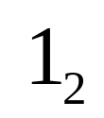
2-1 Binary to Decimal Conversion
Convert binary to decimal by summing the positions that contain a 1.
Ronald Tocci/Neal Widmer/Gregory Moss
Digital Systems: Principles and Applications, 10e
Copyright ©2007 by Pearson Education, Inc.
Columbus, OH 43235
All rights reserved.

Slide 3
2-2 Decimal to Binary Conversion
Two methods to convert decimal to binary:
  Reverse process described in 2-1
  Use repeated division
Ronald Tocci/Neal Widmer/Gregory Moss
Digital Systems: Principles and Applications, 10e
Copyright ©2007 by Pearson Education, Inc.
Columbus, OH 43235
All rights reserved.

Slide 4
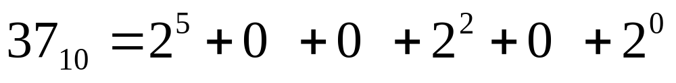
2-2 Decimal to Binary Conversion
Reverse process described in 2-1
  Note that all positions must be accounted for
Ronald Tocci/Neal Widmer/Gregory Moss
Digital Systems: Principles and Applications, 10e
Copyright ©2007 by Pearson Education, Inc.
Columbus, OH 43235
All rights reserved.

Slide 5
2-2 Decimal to Binary Conversion
Repeated division steps:
  Divide the decimal number by 2
  Write the remainder after each division until a quotient of zero is obtained.
  The first remainder is the LSB and the last is the MSB
    Note, when done on a calculator, a fractional answer indicates a remainder of 1.
Ronald Tocci/Neal Widmer/Gregory Moss
Digital Systems: Principles and Applications, 10e
Copyright ©2007 by Pearson Education, Inc.
Columbus, OH 43235
All rights reserved.

Slide 6
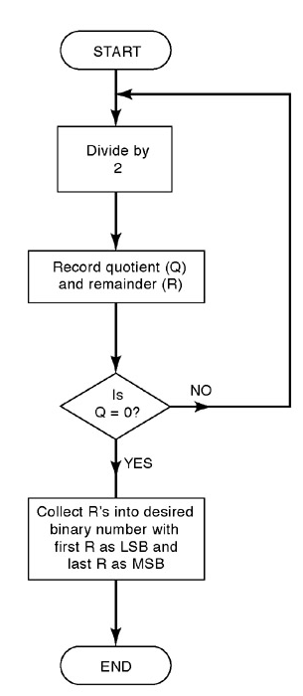
2-2 Decimal to Binary Conversion
Repeated division – This flowchart describes the process and can be used to convert from decimal to any other number system.
Ronald Tocci/Neal Widmer/Gregory Moss
Digital Systems: Principles and Applications, 10e
Copyright ©2007 by Pearson Education, Inc.
Columbus, OH 43235
All rights reserved.

Slide 7
2-3 Hexadecimal Number System
Most digital systems deal with groups of bits in even powers of 2 such as 8, 16, 32, and 64 bits.
Hexadecimal uses groups of 4 bits.
Base 16
  16 possible symbols
  0-9 and A-F
Allows for convenient handling of long binary strings.
Ronald Tocci/Neal Widmer/Gregory Moss
Digital Systems: Principles and Applications, 10e
Copyright ©2007 by Pearson Education, Inc.
Columbus, OH 43235
All rights reserved.

Slide 8
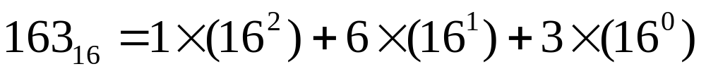
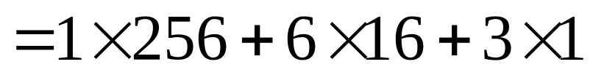
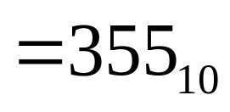
2-3 Hexadecimal Number System
Convert from hex to decimal by multiplying each hex digit by its positional weight.
Example:
Ronald Tocci/Neal Widmer/Gregory Moss
Digital Systems: Principles and Applications, 10e
Copyright ©2007 by Pearson Education, Inc.
Columbus, OH 43235
All rights reserved.

Slide 9
2-3 Hexadecimal Number System
Convert from decimal to hex by using the repeated division method used for decimal to binary and decimal to octal conversion.
Divide the decimal number by 16
The first remainder is the LSB and the last is the MSB.
  Note, when done on a calculator a decimal remainder can be multiplied by 16 to get the result. If the remainder is greater than 9, the letters A through F are used.
Ronald Tocci/Neal Widmer/Gregory Moss
Digital Systems: Principles and Applications, 10e
Copyright ©2007 by Pearson Education, Inc.
Columbus, OH 43235
All rights reserved.

Slide 10
2-3 Hexadecimal Number System
Example of hex to binary conversion:
9F2₁₆ = 9 F 2
1001 1111 0010 = 100111110010₂
Ronald Tocci/Neal Widmer/Gregory Moss
Digital Systems: Principles and Applications, 10e
Copyright ©2007 by Pearson Education, Inc.
Columbus, OH 43235
All rights reserved.

Slide 11
2-3 Hexadecimal Number System
Convert from binary to hex by grouping bits in four starting with the LSB.
Each group is then converted to the hex equivalent
Leading zeros can be added to the left of the MSB to fill out the last group.
Ronald Tocci/Neal Widmer/Gregory Moss
Digital Systems: Principles and Applications, 10e
Copyright ©2007 by Pearson Education, Inc.
Columbus, OH 43235
All rights reserved.

Slide 12
2-3 Hexadecimal Number System
Example of binary to hex conversion.
(Note the addition of leading zeroes)
1110100110₂ = 0011 1010 0110
= 3 A 6
= 3A6₁₆
Counting in hex requires a reset and carry after reaching F.
Ronald Tocci/Neal Widmer/Gregory Moss
Digital Systems: Principles and Applications, 10e
Copyright ©2007 by Pearson Education, Inc.
Columbus, OH 43235
All rights reserved.

Slide 13
2-3 Hexadecimal Number System
Hexadecimal is useful for representing long strings of bits.
Understanding the conversion process and memorizing the 4 bit patterns for each hexadecimal digit will prove valuable later.
Ronald Tocci/Neal Widmer/Gregory Moss
Digital Systems: Principles and Applications, 10e
Copyright ©2007 by Pearson Education, Inc.
Columbus, OH 43235
All rights reserved.

Slide 14
2-4 BCD
Binary Coded Decimal (BCD) is another way to present decimal numbers in binary form.
BCD is widely used and combines features of both decimal and binary systems.
Each digit is converted to a binary equivalent.
Ronald Tocci/Neal Widmer/Gregory Moss
Digital Systems: Principles and Applications, 10e
Copyright ©2007 by Pearson Education, Inc.
Columbus, OH 43235
All rights reserved.

Slide 15
2-4 BCD
To convert the number 874₁₀ to BCD:
8 7 4
0100 0111 0100 = 010001110100_{BCD}
Each decimal digit is represented using 4 bits.
Each 4-bit group can never be greater than 9.
Reverse the process to convert BCD to decimal.
Ronald Tocci/Neal Widmer/Gregory Moss
Digital Systems: Principles and Applications, 10e
Copyright ©2007 by Pearson Education, Inc.
Columbus, OH 43235
All rights reserved.

Slide 16
2-4 BCD
BCD is not a number system.
BCD is a decimal number with each digit encoded to its binary equivalent.
A BCD number is not the same as a straight binary number.
The primary advantage of BCD is the relative ease of converting to and from decimal.
Ronald Tocci/Neal Widmer/Gregory Moss
Digital Systems: Principles and Applications, 10e
Copyright ©2007 by Pearson Education, Inc.
Columbus, OH 43235
All rights reserved.

Slide 17
2-5 Gray Code
The gray code is used in applications where numbers change rapidly.
In the gray code, only one bit changes from each value to the next.
Ronald Tocci/Neal Widmer/Gregory Moss
Digital Systems: Principles and Applications, 10e
Copyright ©2007 by Pearson Education, Inc.
Columbus, OH 43235
All rights reserved.

Slide 18
2-5 Gray Code
Binary Gray Code
000 000
001 001
010 011
011 010
100 110
101 111
110 101
111 100
Ronald Tocci/Neal Widmer/Gregory Moss
Digital Systems: Principles and Applications, 10e
Copyright ©2007 by Pearson Education, Inc.
Columbus, OH 43235
All rights reserved.

Slide 19
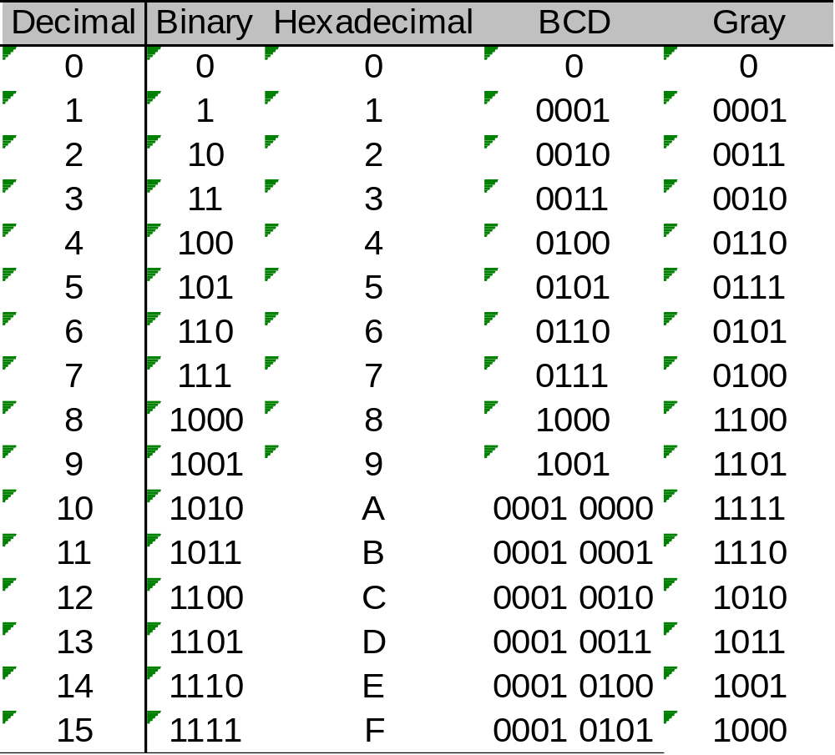
2-6 Putting It All Together
Ronald Tocci/Neal Widmer/Gregory Moss
Digital Systems: Principles and Applications, 10e
Copyright ©2007 by Pearson Education, Inc.
Columbus, OH 43235
All rights reserved.

Slide 20
2-7 The Byte, Nibble, and Word
1 byte = 8 bits
1 nibble = 4 bits
1 word = size depends on data pathway size.
  Word size in a simple system may be one byte (8 bits)
  Word size in a PC is eight bytes (64 bits)
Ronald Tocci/Neal Widmer/Gregory Moss
Digital Systems: Principles and Applications, 10e
Copyright ©2007 by Pearson Education, Inc.
Columbus, OH 43235
All rights reserved.

Slide 21
2-8 Alphanumeric Codes
Represents characters and functions found on a computer keyboard.
ASCII – American Standard Code for Information Interchange.
  Seven bit code: 2⁷ = 128 possible code groups
  Table 2-4 lists the standard ASCII codes
  Examples of use are: to transfer information between computers, between computers and printers, and for internal storage.
Ronald Tocci/Neal Widmer/Gregory Moss
Digital Systems: Principles and Applications, 10e
Copyright ©2007 by Pearson Education, Inc.
Columbus, OH 43235
All rights reserved.

Slide 22
2-9 Parity Method for Error Detection
Binary data and codes are frequently moved between locations. For example:
  Digitized voice over a microwave link.
  Storage and retrieval of data from magnetic and optical disks.
  Communication between computer systems over telephone lines using a modem.
Electrical noise can cause errors during transmission.
Many digital systems employ methods for error detection (and sometimes correction).
Ronald Tocci/Neal Widmer/Gregory Moss
Digital Systems: Principles and Applications, 10e
Copyright ©2007 by Pearson Education, Inc.
Columbus, OH 43235
All rights reserved.

Slide 23
2-9 Parity Method for Error Detection
The parity method of error detection requires the addition of an extra bit to a code group.
This extra bit is called the parity bit.
The bit can be either a 0 or 1, depending on the number of 1s in the code group.
There are two methods, even and odd.
Ronald Tocci/Neal Widmer/Gregory Moss
Digital Systems: Principles and Applications, 10e
Copyright ©2007 by Pearson Education, Inc.
Columbus, OH 43235
All rights reserved.

Slide 24
2-9 Parity Method for Error Detection
Even parity method – the total number of bits in a group including the parity bit must add up to an even number.
  The binary group 1 0 1 1 would require the addition of a parity bit 1 1 0 1 1
    Note that the parity bit may be added at either end of a group.
Ronald Tocci/Neal Widmer/Gregory Moss
Digital Systems: Principles and Applications, 10e
Copyright ©2007 by Pearson Education, Inc.
Columbus, OH 43235
All rights reserved.

Slide 25
2-9 Parity Method for Error Detection
Odd parity method – the total number of bits in a group including the parity bit must add up to an odd number.
  The binary group 1 1 1 1 would require the addition of a parity bit 1 1 1 1 1
Ronald Tocci/Neal Widmer/Gregory Moss
Digital Systems: Principles and Applications, 10e
Copyright ©2007 by Pearson Education, Inc.
Columbus, OH 43235
All rights reserved.

Slide 26
2-9 Parity Method for Error Detection
The transmitter and receiver must “agree” on the type of parity checking used.
Two bit errors would not indicate a parity error.
Both odd and even parity methods are used, but even seems to be used more often.
Ronald Tocci/Neal Widmer/Gregory Moss
Digital Systems: Principles and Applications, 10e
Copyright ©2007 by Pearson Education, Inc.
Columbus, OH 43235
All rights reserved.

Slide 27
2-10 Applications
A CD-ROM stores 650 megabytes of digital data. How many bits of data is this?
Determine the odd parity bit required for each of the following 7 bit ASCII codes:
  _ 1001010
  _ 0101101
  _ 0110101
Determine the even parity bit required for each 7 bit ASCII code listed above.
Ronald Tocci/Neal Widmer/Gregory Moss
Digital Systems: Principles and Applications, 10e
Copyright ©2007 by Pearson Education, Inc.
Columbus, OH 43235
All rights reserved.

